Slide 1
Data-Driven Business Insights for Online Retail
Prepared by: Subhojit Daw

Slide 2
Business Context & Objectives
Provide data-driven insights to support strategic decision-making for business & management
Analyze revenue trends, customer value, and regional performance using clean and validated transactional data
Exclude the United Kingdom from selected analyses to shift focus toward international markets and expansion opportunities, as the UK represents a mature and already well-established market
Identify high-growth regions, high-value customers, and seasonal demand patterns to inform forecasting, marketing prioritization, and expansion strategies

Slide 3
Dataset Overview
Dataset Name (Source): Online Retail Dataset (UCI Machine Learning Repository)
Online retail transactional dataset
Key fields: Invoice Date, Country, Customer ID, Quantity, Unit Price
Number of instances: 541,909
Dataset used to analyze sales performance and demand patterns

Slide 4
Data Cleaning & Preparation
Removed returned items where Quantity < 1
Removed incorrect entries where Unit Price < 0
Created Revenue metric: Quantity × Unit Price
Ensured reliable and accurate analysis

Slide 5
Key Business Questions
What are the seasonal revenue trends?
Which countries generate the highest revenue?
Who are the highest value customers?
Which regions show strong demand for expansion?

Slide 6
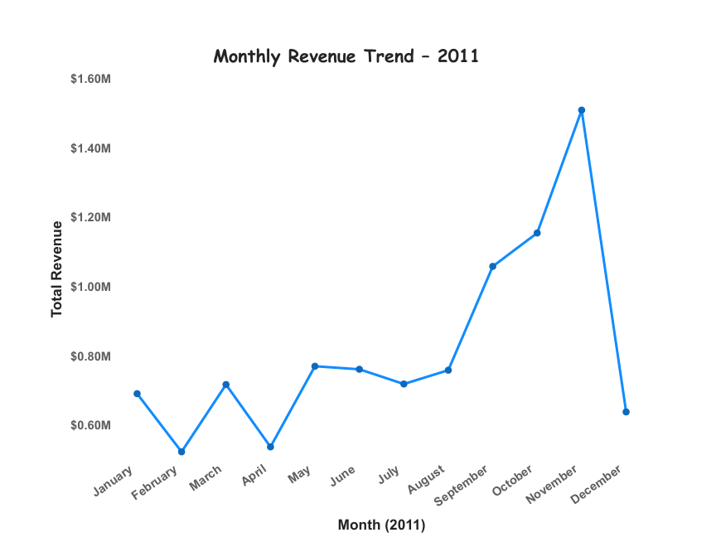
Insight 1: Monthly Revenue Trends (2011)
Line chart used to analyze monthly revenue for 2011
Clear seasonal peaks observed in late Q4
Supports forecasting and inventory planning

Slide 7
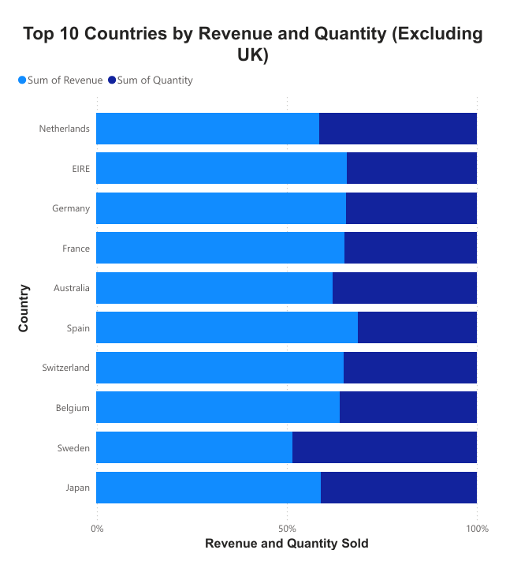
Insight 2: Top Countries by Revenue
Top 10 countries analyzed excluding the UK
Revenue and Quantity compared using stacked bar chart
Helps identify high-performing international markets

Slide 8
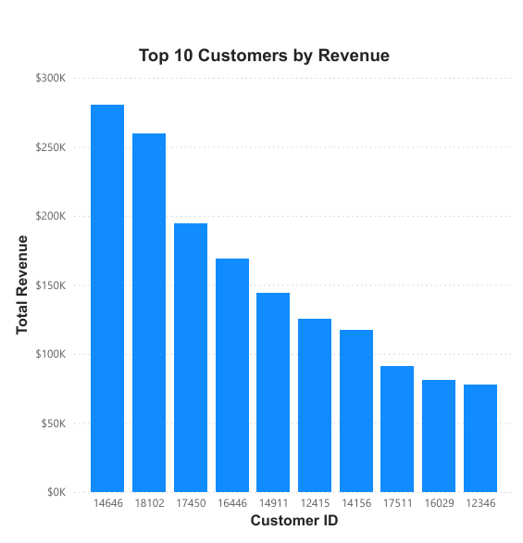
Insight 3: Top 10 Customers by Revenue
Revenue contribution analyzed by customer
Small group of customers generates significant revenue
Supports targeted retention and loyalty strategies

Slide 9
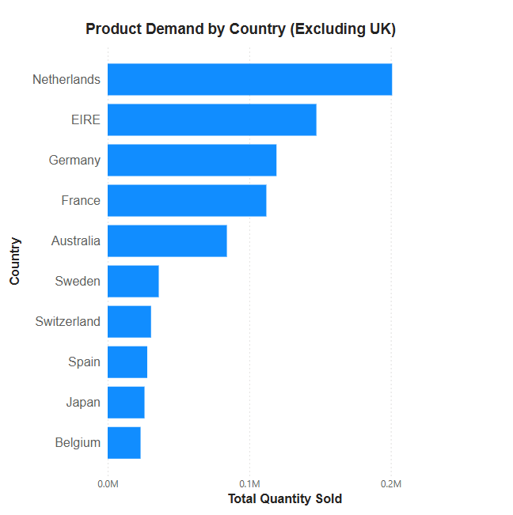
Insight 4: Product Demand by Country
Demand measured using total quantity sold
High-demand regions identified for expansion
UK excluded to focus on growth opportunities

Slide 10
Key Recommendations
Use seasonal trends for better forecasting
Focus marketing efforts on high-performing countries
Prioritize retention of high-value customers
Explore expansion in high-demand regions

Slide 11
Tools & Technologies Used
Power BI for data visualization
Excel dataset for analysis
Data cleaning and transformation techniques

Slide 12
Conclusion
Clean data enables accurate decision-making
Visual analytics bridges data and leadership decisions
Insights support growth, retention, and expansion strategies

